Slide 1



Notes on Time of Use (TOU) Electric Vehicle Charging
Jose A. Mawyin

Slide 2

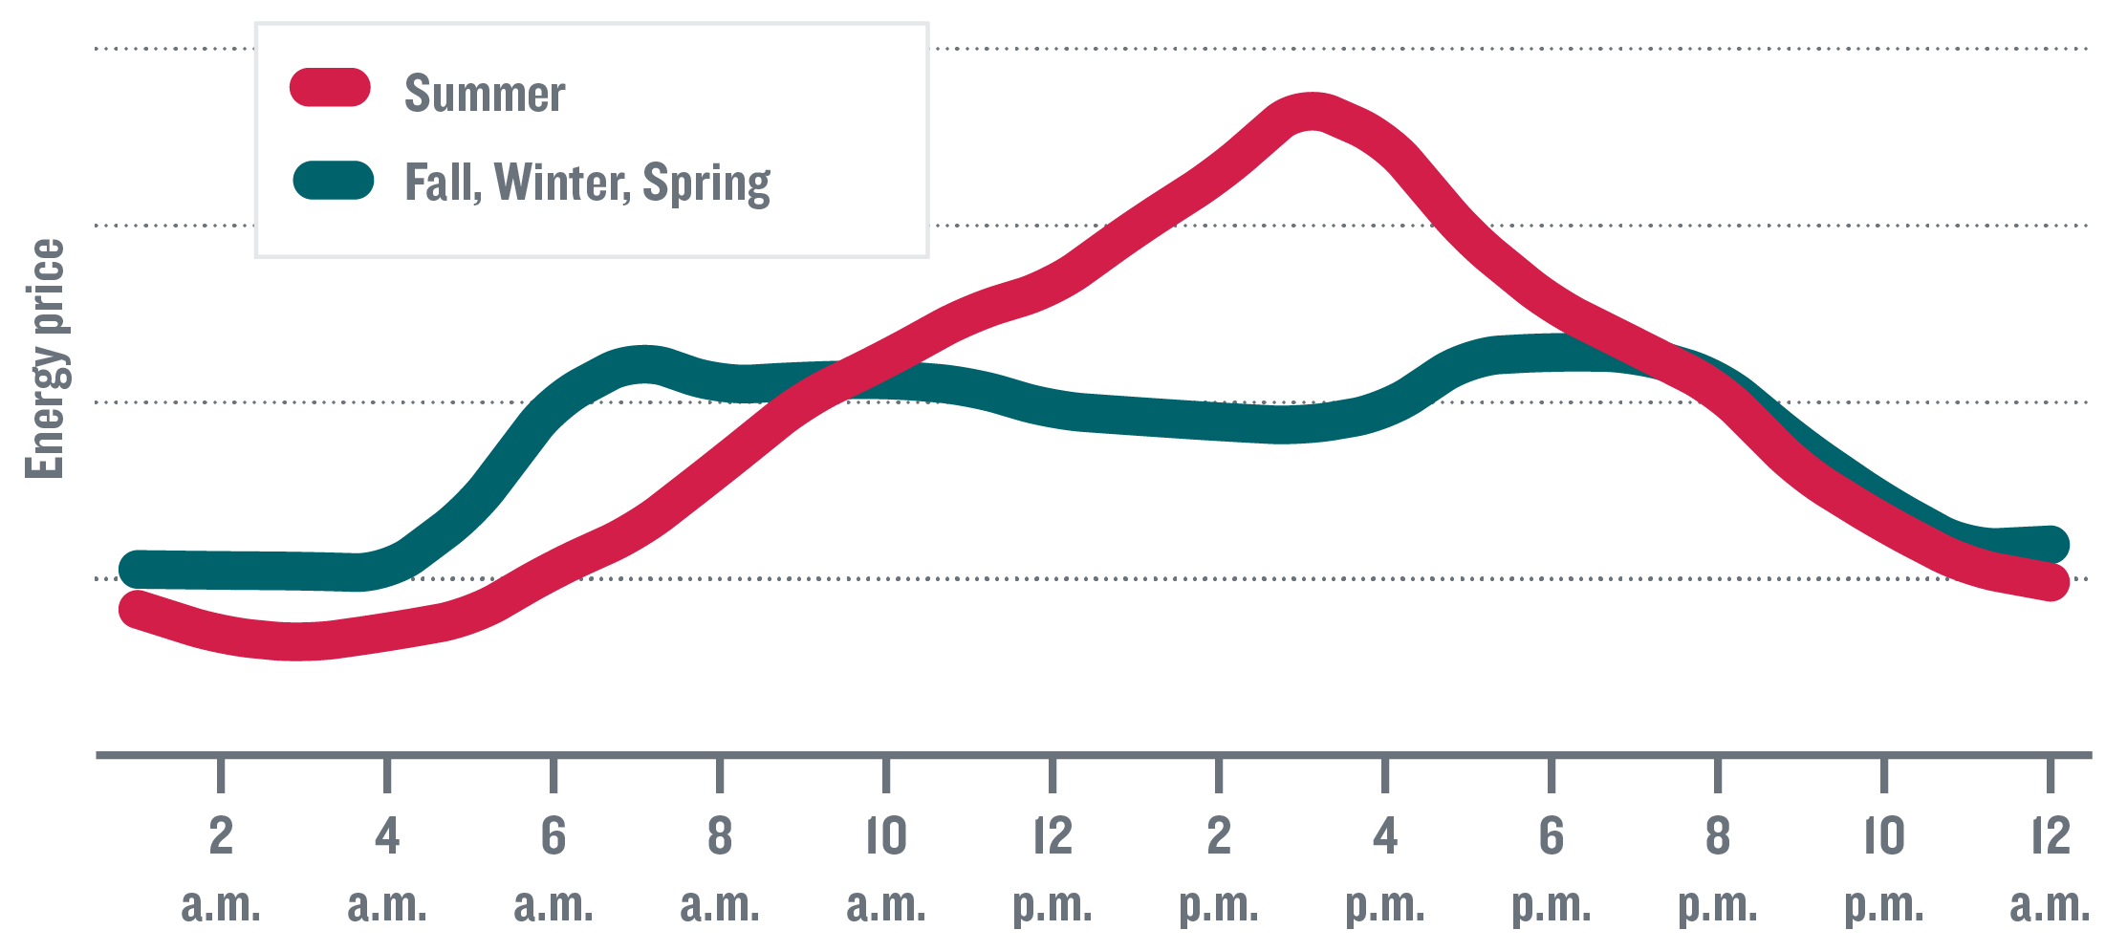
(Bottom):How EV's Change Home Electricity Load Profiles
(Top):Typical pricing patterns based on average prices for January 2016 through December 2019. Com Ed
z

Slide 3
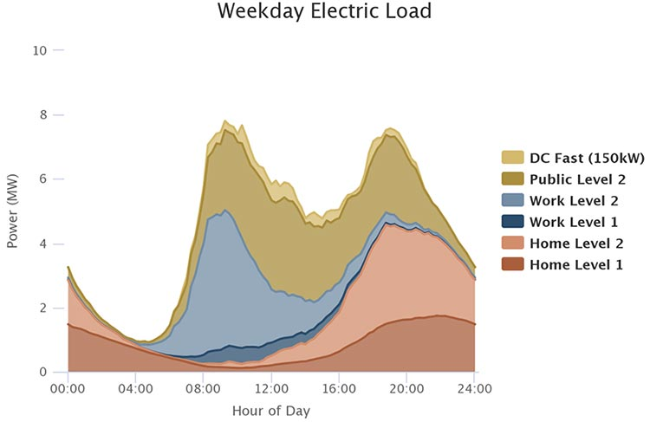
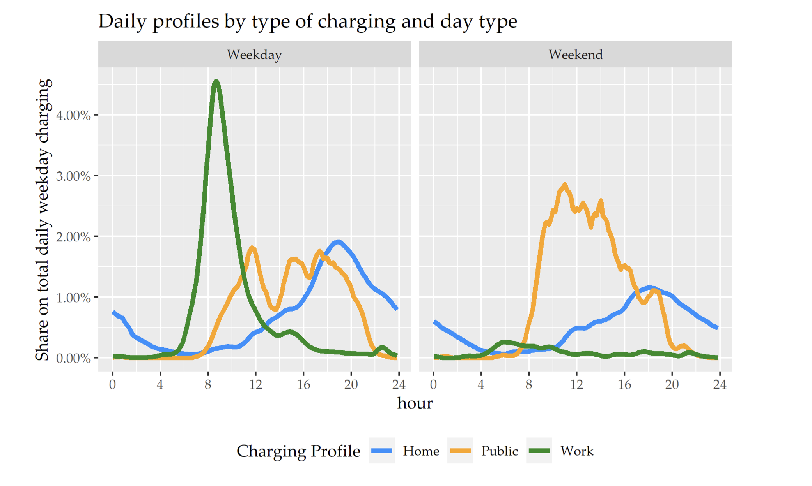
(Bottom): Influence of EV charge location (work, public and home) on hourly profile. “Cross-Country Comparison of Hourly Electricity Mixes for EV Charging Profiles”
(Top):Influence of EV charger level (Level. 1 or 2) and location of charging on electric load.
“How Might Electric Vehicles Affect Electric Loads? Expanded Online Tool Provides Quick Answers”
z

Slide 4
Balance of Objectives of Optimal ToU Charging:
Objective 1:
To minimize the total charging cost.
“The problem is cast as a daily decision-making problem for choosing the amount of energy to be charged in the PEV battery within a day.” (Ref.1)
Objective 2:
To minimize the peak load.
“Large scale of Electric Vehicles(EVs) connected into the power grid will cause a significant impact on distribution network, such as network loss, voltage drop, etc.” (Ref.2)

Slide 5
Issues to be considered
What is the charging schemes?:
a per-EV, decentralized, decision process or
a centrally controlled charging scheme. Both schemes with pros and cons. (Ref.3)
What is the charging strategy?
Reduce cost to EV user
Balance grid for benefit of operator.

Slide 6
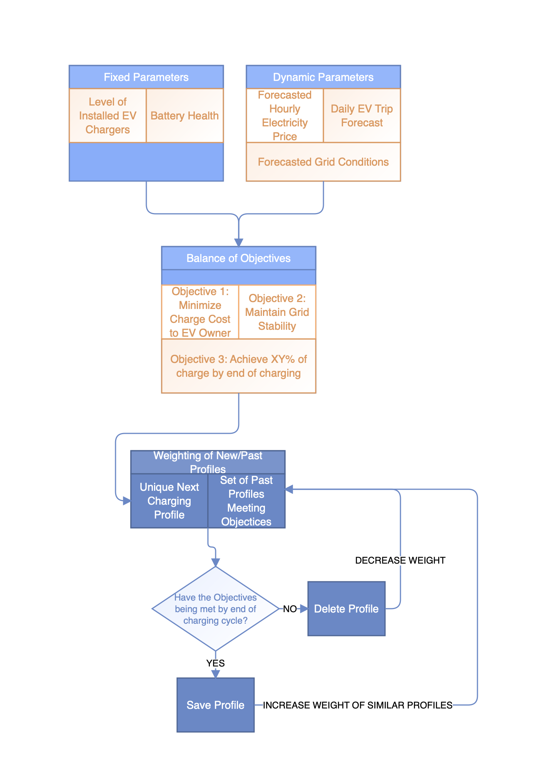
Flow of Possible Control Mechanism
z

Slide 7

Literature Review:
Reinforcement Learning-Based Plug-in Electric Vehicle Charging with Forecasted Price (Ref.1)
Research of EV’s Charging and Discharging Control Considering Demand Response (Ref.2)
Planning Electric-Drive Vehicle Charging under Constrained Grid Conditions (Ref.3)
Impact of TOU Rates on Distribution Load Shapes in a Smart Grid with PHEV Penetration (Ref.4)
Using Price Based Signals to Control Plug in Electric Vehicle Fleet Charging
Demand Side Management for EV Charging/Discharging Behaviors with Particle Swarm Optimization
A distributed charging strategy based on day ahead price model for PV-powered electric vehicle charging station
Price-responsive early charging control based on data mining for electric T vehicle online scheduling
Discount based Pricing and Capacity Planning for EV Charging under Stochastic Demand
PSO based Method to Find Electric Vehicle’s Optimal Charging Schedule under Dynamic Electricity Price
Price Based Electric Vehicle Charging
Charging of EV with Constant Price Using PV Based Grid Connected Systems
Optimization Strategy of Electric Vehicle Charging Based on Electricity Price Demand Response

